Slide 1
SGLang v0.2: Faster Interface and Runtime for LLM inference

Slide 2
Aug - Dec.
2023
Early Stage: the “programming LLM” paradigm
Jan. - now
2024
Middle Stage: innovative features and optimizations
now -
2024
Production Stage: research and industry use-cases

Slide 3
Early Stage: the “Programming LLM” Paradigm
From chat and simple prompting to programmatic usage of LLMs
Multiple calls
Advanced prompting
Simple Chat
LLM Programs
Control flow
Tool use
External interaction
Notes:
Our project is motivated by the emerging paradigm of programming LLM.
Recent increases in the capabilities of LLMs have broadened their utility, enabling them to tackle a wider range of general tasks and act as autonomous agents.
⬇️ In such applications, LLMs engage in multi-round planning, reasoning, and interaction with external environments.
The emergence of these complex patterns signifies a shift in our interaction with LLMs, moving from simple turn-based chatting to a more sophisticated form of programmatic usage of LLMs
⬇️ These new use cases require multiple, often dependent, LLM generation calls. They also include advanced prompting techniques like multi-chain-of-thought, skeleton-of-though, and tree-of-thought.
The generation process can be interleaved with control flow.
The LLM can also use tools and interact with external environment.
We call this new way of using LLM as “Programming LLM”.
The initial , we will think about how to optimize for these new kinds of workloads form a system perspective.

Slide 4
Existing Systems
Early Stage
Front end language: ignored runtime optimizations
(Guidance, LMQL)
Backend Inference engine: do not know program structure
(NVIDIA TensorRT-LLM, vLLM)
Notes:
Because of the importance of these applications, there are some prior work on addressing either the programmability and runtime efficiency problems. However, their developments are evolving along separate trajectories.
On the frontend side, there are some front end languages like Guidance and LMQL that can make the programming easier. However, they largely ignore the runtime optimizations.
On the backend side, there are also inference engines like NVIDIA TensorRT-LLM, vLLM. However, these engines are designed for single generation calls and does not know the program structure.
So all of them miss many optimization opportunities due to the lack of an co-design approach.

Slide 5
Early Stage
Opportunity: KV Cache Reuse
Turn 1 (Q)
Turn 1 (A)
(a) Multi-turn chat
Chat History
Turn 2 (Q)
Turn 2 (A)
Chat History
Turn 3 (Q)
Turn 3 (A)
Chat History
Turn 4 (Q)
Turn 4 (A)
Prompt 1
Few-shot examples
Question 1
Answer 1
(b) Few-shot learning
Prompt 2
Few-shot examples
Question 2
Answer 2
Prompt 3
Few-shot examples
Question 3
Answer 3
Answer 1
Generation 1
(c) Self-consistency
Prompt
Question
Answer 2
Generation 2
Answer 3
Generation 3
Notes:
Let me give you some examples. We start from the most basic use case of LLM, chatbot.
Even with this simple chatbot, there are some structures that we can utilize.
In a chat setting, the user first asks a question, denoted as a green box here. The LLM then generates a response, denoted as a yellow box here.
Most systems just optimize for a single turn, or a single pair of green and yellow box.
⬇️ However, as the chat session continues, the chat history accumulates. We will then have turn two, turn three, and more turns.
This accumulated structure brings some runtime optimization opportunities.
In the LLM generation process, the KV cache is some intermediate tensors generated during the forward pass and will be reused for decoding future tokens.
As the KV cache only depends on prefix tokens, so different sequences with the same prefix can reuse the KV cache and avoids the redundant computation.
In this case, all the blue boxes can be reused.
This is only one case. Actually, these sharable structures appear in lots of common LLM workloads.
⬇️ Another case is few-shot learning. In the few-shot learning setting, different prompts can share the same set of few-shot examples. So the KV cache of the few-shot examples can be shared. The blue boxes denote the shareable part.
⬇️ The third case is the self-consistency prompting technique. This technique generates multiple solutions for the same question and do a majority vote over the solutions. In this case, the question can be shared.
While some of them have been explored by existing systems like vLLM before, they often require manual specification or ad-hoc adjustment.

Slide 6
Opportunity: Parallelism
Early Stage
Generating two tips for staying healthy:
Tip 1: Regular Physical Activity
Engage in regular exercise or physical activities. This doesn‘t necessarily mean hitting the gym every day; it can be as simple as walking, cycling, yoga, or swimming...
1. Regular Physical Activity
expand
Tip 2: Balanced Diet
Consume a balanced diet that includes a variety of nutrients. This means incorporating fruits, vegetables, whole grains, lean proteins, and healthy fats into your meals. A balanced diet ensures …
2. Balanced Diet
expand
Notes:
Okay, let us talk about parallelism. I will use the 'skeleton-of-thought' prompting technique as an example.
Here, I present the computational graph.
Consider a user's question: 'generate two tips for staying healthy'
To do this, we can first generate an outline with two very short tip titles, such as regular physical activity and balanced diet.
⬇️
Then, we can issue parallel generation calls to expand these two tips into detailed paragraphs.
This approach facilitates intra-program parallelism.

Slide 7
System Challenges
Early Stage
How to program these LLM applications?
How to optimize across multiple LLM calls?
Notes:
There are both challenges and opportunities in this new paradigm of complex LLM programs.
To fully utilize the structure and opportunities, we need to consider how to program these applications easily and how to accelerate the execution of these programs by optimizing across multiple LLM generation calls.

Slide 8
Introducing SGLang: A Structured Generation Language
Early Stage
A “co-design” approach
Front end
- A new domain specific language embedded in Python
- Automatic parallelization and other compiler optimizations
Back end
- Automatic KV cache reuse with RadixAttention
Notes:
To address the challenges and capitalize on the optimization opportunities, we introduce SGLang, a structured generation language for controlling the generation process of LLMs.
The concept behind SGLang is to co-design a flexible front-end domain-specific language and a high-performance runtime.
On the front end, we propose a new domain-specific language embedded in Python. It seamlessly integrates with Python's syntax, control flow, and libraries.
We have developed an interpreter and a compiler to automatically parallelize the computational graph and do additional compiler optimizations.
On the back end, our primary innovation is to enable automatic key-value (KV) cache reuse with RadixAttention, a technique that I will detail later.

Slide 9
API example: A Multi-Dimensional Essay Judge
Early Stage
dimensions = ["Clarity", "Originality", "Evidence"]
@function def essay_judge(s, essay): s += "Please evaluate the following essay. " + essay
# Evaluate an essay from multiple dimensions in parallel forks = s.fork(len(dimensions)) for f, dim in zip(forks, dimensions): f += ( "Evaluate based on the following metric: " + dim + ". End your judgement with the word 'END'") f += "Judgment: " + f.gen("judgment", stop="END")
# Merge judgments for f, dim in zip(forks, dimensions): s += dim + ": " + f["judgment"]
# Generate a summary and give a score
s += "In summary," + s.gen("summary")
s += "I give the essay a letter grade of " + s += s.gen("grade", choices=["A", "B", "C", "D"])
ret = essay_judge.run(essay="A long essay ...") print(ret["grade"])
Frontend
Launch parallel prompts
Non-blocking generation call
Fetching generation results
Constrained generation
Run the function
Notes:
First, Let me demonstrate the API using Python code.
Our goal with this function is to assess the quality of an essay from multiple dimensions.
First, we input an essay and initiate several parallel prompts. Each prompt evaluates the essay's quality from a specific dimension, such as clarity, originality, and evidence support.
After gathering these evaluations, we consolidate them into a summary. Finally, we assign a letter grade, choosing from A, B, C, or D.
⬇️ The highlighted section illustrates our API's functionality. With ".fork," we can generate parallel prompts,
⬇️ With ".gen”, it allows us to invoke an LLM generation. This call is non-blocking, allowing the generation to proceed in the background.
⬇️ We can employ native Python syntax to retrieve the generation results.
⬇️ We can also impose additional constraints on the generation for more controlled decoding.
⬇️ This line feeds in the input arguments and execute the function. To execute the function, we can either run it through an interpreter or compile it into a computational graph for execution by a graph executor. In both cases, whether using the interpreter or the graph executor, the system manages synchronization and parallelism within the function instance.

Slide 10
Compiler Optimizations
Early Stage
Building a dataflow graph
Remove Python Interpreter Overhead
Global scheduling optimization over the graph
Prefetching cached prefixes
Insert prefetching nodes into the graph
Code movement for increasing sharable prefix length
Reorder some prompt elements with the help of GPT-4
Frontend
Backend
Notes:
If users write a prompting workflow in our API, we can do some interesting compiler optimizations.
For instance, we can trace a data flow graph from the program and execute it without the overhead of the python interpreter.
Additionally, we can incorporate prefetch nodes into the graph to preload cached long prefixes, provided we can pre-calculate some frequently used long prefixes.
We have also explored a classic compiler optimization - code movement - in our context. In this scenario, code movement corresponds to rearranging parts of the prompt.
Since these prompts are in natural language, we cannot employ traditional program analysis tools for this purpose. Instead, we use GPT-4 to determine the validity of a code movement.
As it changes the original prompt, this represents a more aggressive optimization.

Slide 11
Prefix caching from request tracking?
Early Stage
In multi-turn chat, retrieval tasks, etc
The interpreter tracks the request id (rid) and caches the history before it ends.
Only needs to match the rid.
“pin” is a primitive of fixing a prefix to be cached.
“fork/join” primitives
Frontend
Backend
Fork 1
prefix
Fork 2
join
Prefix + Fork 1 + Fork 2 + Fork 3
Fork 3
Cannot reuse shared prefix across requests!
Notes:
If users write a prompting workflow in our API, we can do some interesting compiler optimizations.
For instance, we can trace a data flow graph from the program and execute it without the overhead of the python interpreter.
Additionally, we can incorporate prefetch nodes into the graph to preload cached long prefixes, provided we can pre-calculate some frequently used long prefixes.
We have also explored a classic compiler optimization - code movement - in our context. In this scenario, code movement corresponds to rearranging parts of the prompt.
Since these prompts are in natural language, we cannot employ traditional program analysis tools for this purpose. Instead, we use GPT-4 to determine the validity of a code movement.
As it changes the original prompt, this represents a more aggressive optimization.

Slide 12
Aug - Dec.
2023
Early Stage: the “programming LLM” paradigm
Jan. - now
2024
Middle Stage: innovative features and optimizations
Focused efforts on backend/runtime performance
now -
2024
Production Stage: research and industry use-cases

Slide 13
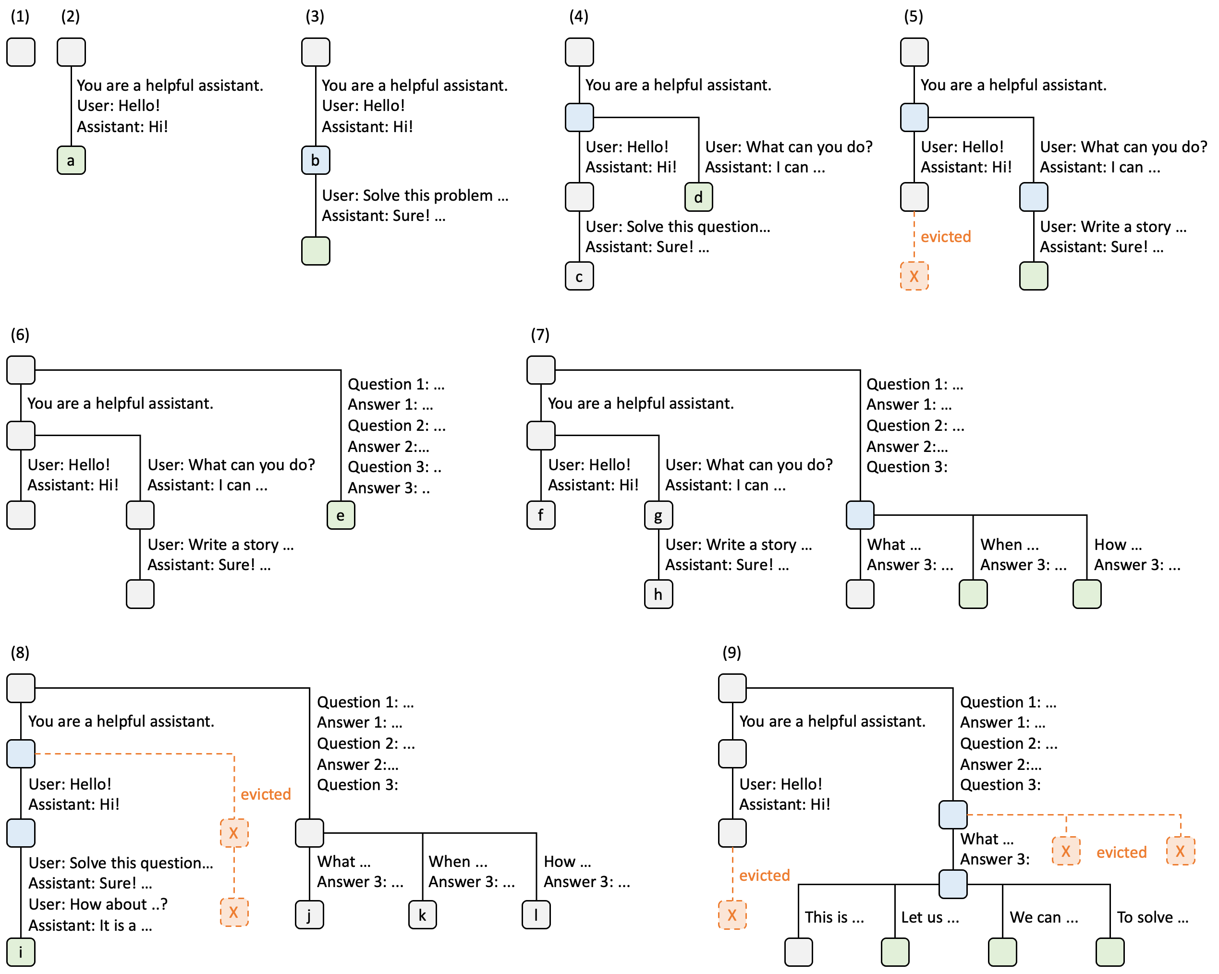
Runtime (SRT) with RadixAttention
Middle Stage
Existing Systems: Discard KV cache after a request finishes.
Ours: Maintain an LRU cache of the KV cache of all requests in a radix tree (compact prefix tree).
Notes:
Okay, now let us move to the runtime side.
On the runtime side, we propose RadixAttention for automatic KV cache reuse.
In existing systems, the KV cache of a request is discarded after a request finishes. This prevents the KV cache reuse across multiple calls.
In our design, we never discard any KV cache, instead, we store the KV cache of both prompts and generation results in a radix tree. Radix tree is a type of space optimized prefix tree.
However, the GPU memory is limited, so we cannot store all of them. An eviction policy is required.
We implemented an LRU eviction policy and designed a cache-aware scheduling policy. Combining them leads to automatic KV cache reuse across multiple calls and multiple batches. Our technique is compatible with existing techniques like continuous batching and paged attention.
Here I show several examples on how we maintain the RadixAtention tree.
We demonstrate the dynamic evolution of the radix tree in response to various requests. These requests include two chat sessions, a batch of few-shot learning inquiries, and a self-consistency sampling.
⬇️ In step (1), the radix tree is initially empty with only a root node.
⬇️ In step (2), the server processes an incoming user message "Hello" and responds with the LLM output "Hi". We consolidate the system prompt "You are a helpful assistant", the user message "Hello!", and the LLM reply "Hi!" as a single edge and link it to a new node in the tree. We label each edge with a substring, which is just a sequence of tokens.
⬇️ In step (3), a new prompt arrives and the server finds the prefix of the prompt in the radix tree, which is the first turn of the conversation, so this triggers a cache hit and we can reuse its KV cache. The new turn is appended to the tree as a new node.
The nodes are color-coded to reflect different states: green for newly added nodes, blue for cached nodes accessed during the time point.
⬇️ In step (4), a new chat session begins. The node ``b'' from (3) is split into two nodes to allow the two chat sessions to share the system prompt.
⬇️ In step (5), the second chat session continues. However, due to the memory limit, node "c" from (4) must be evicted. The new turn is appended after node "d" in (4).
We use red to denote the nodes that have been evicted.

Slide 14
Runtime (SRT) with RadixAttention
Middle Stage
Maintain an LRU cache of the KV cache of all requests in a radix tree.
Notes:
Okay, let us go through more examples.
In step (6), the server receives a few-shot learning query, processes it, and inserts it into the tree. The root node is split because the new query does not share any prefix with existing nodes.
⬇️ In step (7), the server receives a batch of additional few-shot learning queries. These queries share the same set of few-shot examples, so we split node 'e' from (6) to enable sharing.

Slide 15
Runtime (SRT) with RadixAttention
Middle Stage
Maintain an LRU cache of the KV cache of all requests in a radix tree.
Notes:
Let us continue.
In step (8), the server receives a new message from the first chat session. Due to the memory constraint, it evicts all nodes from the second chat session (node "g" and "h") as they are least recently used. But we still keep the branch for the few-shot learning queries.
⬇️ In step (9), the server receives a request to sample more answers for a questions in node "j" from (8), likely for self-consistency prompting. To make space for these requests, we evict more nodes.
For the new query, the prefix is already in the radix tree and it is a cache hit, as denoted by the blue boxes.
⬇️ By maintaining the KV cache with a radix tree, we can efficiently do prefix matching, node insertion, and node deletion.
This enables automatic KV cache reuse across multiple calls.
We also implemented a cache-aware scheduling to increase the cache hit rate.
To demonstrate the advantage of co-design, we also let the interpreter send hints to the backend and simplify the maintenance of the radix tree.

Slide 16
Cache Aware Scheduling
Middle Stage
In the request queue, sort the requests according to the matched prefix length
Achieves good cache hit rate
Future work
Distributed cache aware scheduling for multiple data parallel workers
Fairness to prevent starvation (https://arxiv.org/abs/2401.00588)
Notes:
In addition to the data structure, we also implemented a cache aware scheduling policy to further improve the cache hit rate.
For all requests in the queue, we sort the request according to the matched prefix lengths, so we can prioritize requests with more cache hit.
This can greatly improve the throughput for some workload.
There is still room for improvement, we are working on some additional questions about this.
For example, if you have multiple data parallel workers, how do you do this kind of scheduling.
Another topic is about how to ensure fairness and prevent starvation when we use this kind of greedy scheduling policy.

Slide 17
Aug - Dec.
2023
Early Stage: the “programming LLM” paradigm
Jan. - now
2024
Middle Stage: innovative features and optimizations
RadixAttention
Upper-level Scheduling
now -
2024
Production Stage: research and industry use-cases

Slide 18
SGLang Structure: Pipeline
Middle Stage
Server
Tokenizer
Manager
Detokenizer
TP 0
TP 1
TP 2
TP 3
Notes:
Let's take an overall look at our structure. It comprises three pipeline stages: a tokenizer, a model forward manager, and a detokenizer. These stages correspond to three natural LLM inference phases, which were first introduced by LightLLM.
The pipeline design allows for overlap between the tokenizer and the model at a higher level.
⬇️ To support tensor parallelism, each tensor parallelism part is managed and synchronized by the manager. Here's how this works:
A full forward pass proceeds as follows:
1. Requests are received by the server endpoint and sent to the tokenizer, which converts natural language text into token IDs.
2. During each forward step, the manager prepares a batch. This includes allocating memory, batching the tensor, mapping the indices in the attention backend, and then sending the batch to all the tensor parallelism (TP) parts.
3. After the TP parts get the next token IDs, the detokenizer performs similar operations to the tokenizer, marking the end of the forward pass.

Slide 19

SGLang Structure: Inside TP Worker
Middle Stage
1.Decode Batch
2.Prefill a New Batch
3.Decode Batch
Merge into decode batch
ready for decode
EOS token, finished this req
newly decoded token
prompt tokens
EOS (newly decoded)
decoded token
How to always keep the batch size large enough?
Notes:
Let's dive into some details of the manager and the TP worker. As the slide shows, our scheduling is assigned to different batches, which involves techniques like continuous batching and token attention (paged size = 1).
Here is a simple demonstration of our batch-level scheduling without radix attention.
First, consider a decode batch. Each request in this batch receives a new predicted token, and there is an End-of-Sequence (EOS) token present.
⬇️ We will filter out the requests that have reached an EOS token and attempt to add new requests into the decoding batch in the second step.
The newly added prefill requests will start decoding along with the other ongoing decoding requests in the next step. To maximize throughput and scale up the ability of larger batch sizes, how can we ensure that the batch size is always sufficient?

Slide 20
Dynamically Adjust the new token ratio estimation
Middle Stage
The max context length
decided by max new tokens
There is a lot of space left in the GPU memory
We do not need to reserve every token in max new tokens
Notes:
One of the problems we face is that sometimes we reserve space for tokens expected to come, but the batch size remains small due to this reserved space.
Actually, we would not need to reserve space for every token decided by the max new tokens, which is input by users.

Slide 21

Dynamically Adjust the new token ratio estimation
Middle Stage
Max new tokens
Prompt Length
Memory to be released
The EOS would be earlier than the max new tokens.
There are always requests finished and release all the memory.
Only preserve $β ×$max_new_token tokens in advance, and adjust $β$ dynamically.
Notes:
here are two intuitive reasons why we do not need to reserve space for all the new tokens: 1. In a real serving scenario, the EOS token often appears earlier than the maximum number of new tokens, and it is difficult to predict exactly when it will appear.
2. Sequence lengths in a decoding batch vary significantly. Sometimes, the shape of the sequences in a batch resembles a staircase, with different lengths for each request. As a result, there are always some requests that meet an EOS token and can finish earlier, freeing up memory that can be used by other ongoing requests or to accommodate new prefill requests.
⬇️One solution is that we maintain a ratio beta, only preserve beta multiplies max new tokens in advance, and adjust the beta dynamically.

Slide 22
Aug - Dec.
2023
Early Stage: the “programming LLM” paradigm
Jan. - now
2024
Middle Stage: innovative features and optimizations
RadixAttention
Upper-level Scheduling
Jump-forward decoding
now -
2024
Production Stage: research and industry use-cases

Slide 23
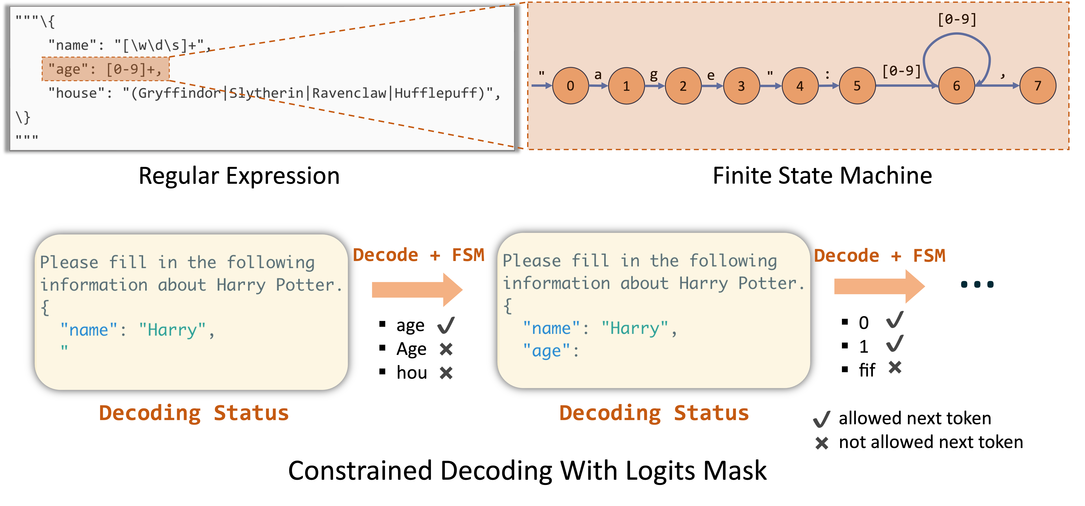
Middle Stage
Jump-forward JSON Decoding
Method
Analyze the regular expression
Compress the finite state machine
Decode multiple tokens at the same time
Notes:
If we want to guide LLM to follow some regular expression, how should we do and how can we speed up the process?
The most regular method to do that Is through Finite State Machine (FSM).
⬇️ Every regular expression can be converted into an equivlent FSM, and we can track the current status according to previous generated tokens, then located which node we are on the FSM.
Once we know which node we are on, then we can find out the allowable tokens and forbidden tokens for next step. This is how FSM constrained the decoding process of a regular expression.

Slide 24
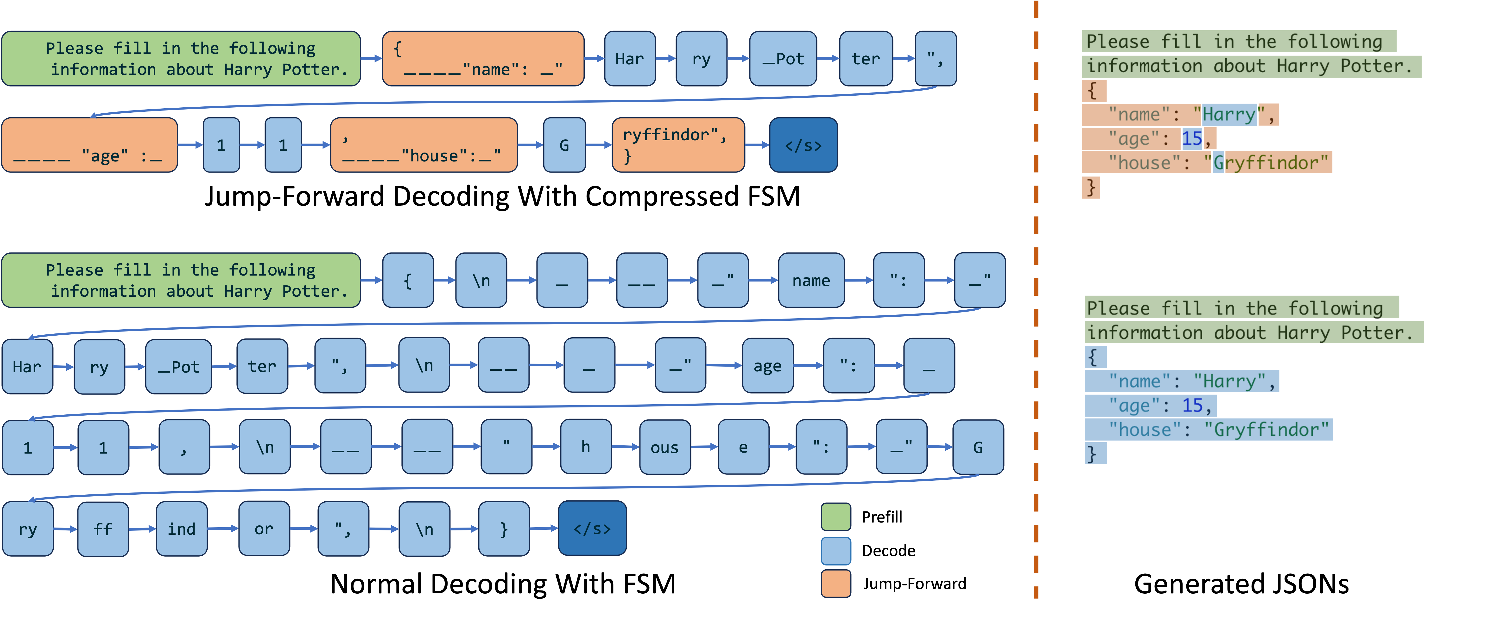
Speedup Regex Guided Generation
Middle Stage
Notes:
This guided generate process gives us an acceleration opportunity. We can find that if we strictly follow the constraints, there are a lot of constant parts in the regular expression. That is, this part is fixed string like keys and formats in JSON.
In the example shown on the right, the orange-painted part is the constant part. Instead of decoding his part token by token, we can decode them together.
This process in the FSM, is, that when we arrive at a node which has only one outgoing edge, then we can know the next serval tokens in advance, rather than using LLM to predict them.

Slide 25
Middle Stage
Jump-forward JSON Decoding
Results:
3x faster latency
2.5x higher throughput

Slide 26
Summary: techniques in SGLang
Middle Stage
RadixAttention
Jump-forward JSON Decoding
Torch Compile
Flashinfer Kernels
Chunked Prefill
Continuous Batching
Token Attention(Paged Attention with page_size = 1)
CUDA Graph
Interleave window attention

Slide 27
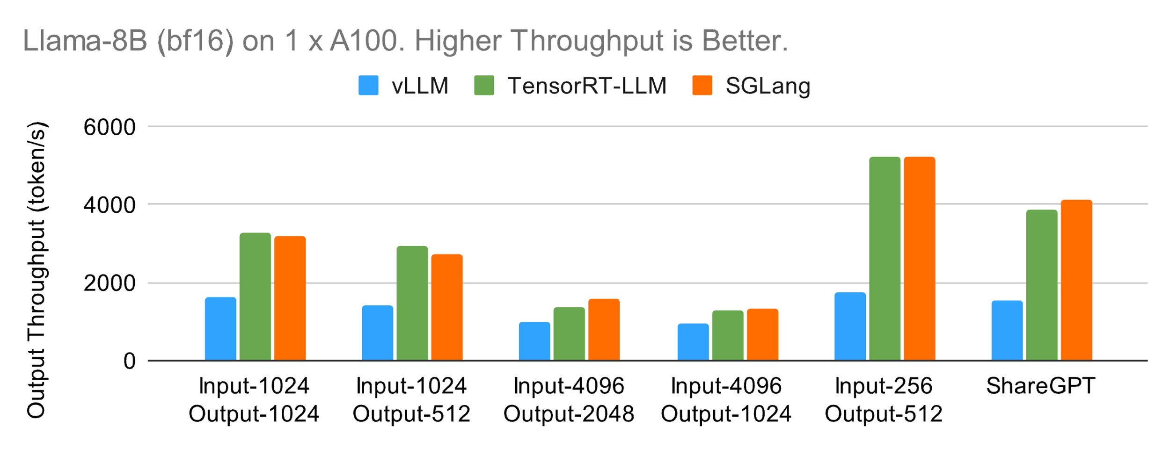
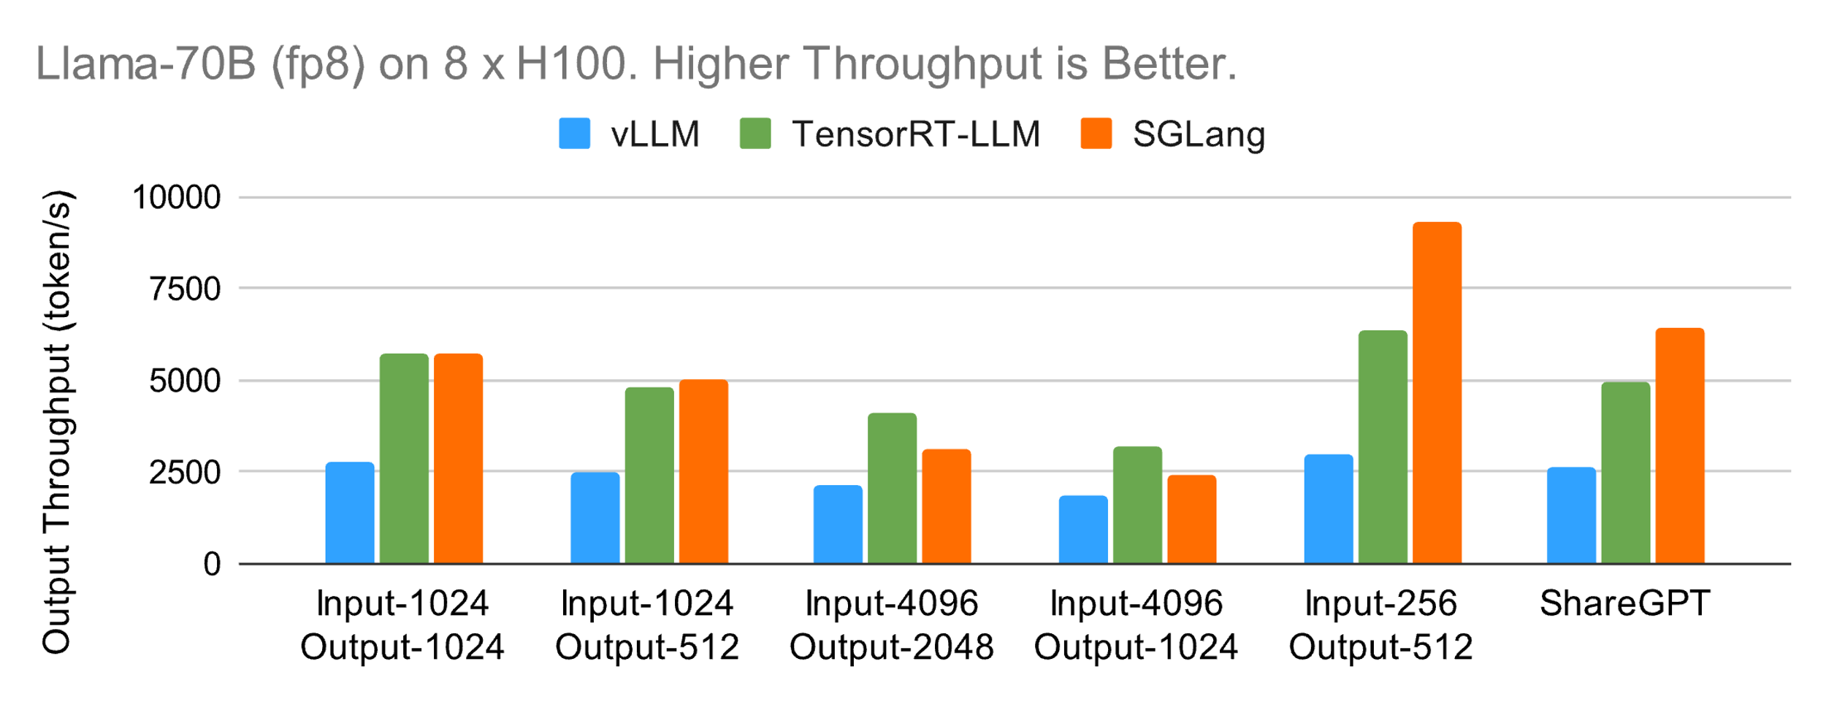
SGLang v0.2 Results
Middle Stage

Slide 28
Aug - Dec.
2023
Early Stage: the “programming LLM” paradigm
Jan. - now
2024
Middle Stage: innovative features and optimizations
now -
2024
Production Stage: research and industry use-cases

Slide 29




Research and industry use cases
Production Stage
x.ai: Production serving of grok-2 and grok-2-mini on X
Databricks: accelerate research workflow by 3x
LMSys Chatbot Arena: serving vision language models
LLaVA OneVision: serving multi-modal image and video models

Slide 30
Future work
Production Stage
multi-level cache
distributed radix attention
long-context
speculative decoding
communication overlapping
……

Slide 31
Production Stage
Do the serving engines come to converge on performance?
YES and NO
Basic performance eventually converge
But there are more sophisticated workloads from different scenarios:
RAG systems, agent systems, …
We never forget about the origin of SGLang!
Structured inputs, interactions with different resources, multi-modality, …

Slide 32
Principles in future development
Production Stage
Simplism
Minimalism
Modularity
Ease of use
Development velocity
Performance

